Slide 1

FIRST Sunday in Advent
Sunday, November 29th
ADVENT I – HOPE
Isaiah 60: 2-3a; Luke 21: 25-26

Slide 2
First Sunday in Advent
A lay person or persons may be invited forward to lead the congregation.
One:
This is the day we begin our journey to the Child, his Mother and the manger.
All :
May we kindle God’s light together as we journey on.

Slide 3
One:
It is a journey shrouded in a fading sun and a growing uncertainty as the world turns cold.
And we journey anyway.
All:
May we kindle God’s light together as we journey on.
One:
We journey because we are drawn to God’s light at the end: it is God’s promise, borne into our lives.
All:
May we kindle God’s light together as we journey on.

Slide 4
One:
This is the day we begin our journey. May we kindle God’s light within us, together, as we journey on.
All:
Amen.

Slide 5
Lighting the First Candle
One:
We light this candle in Hope.
The candle of Hope is lit.
We bring this light of hope with us, together, on this journey. Hope comes from the Child and our hope is dedicated to the Child lying in a manger. Seeking goodness only, for our neighbors and for ourselves, may we kindle God’s light of hope within us.
The first verse of “O Little town of Bethlehem” may be sung in response. Following the carol response, the leader may lead the congregation in this prayer.

Slide 6

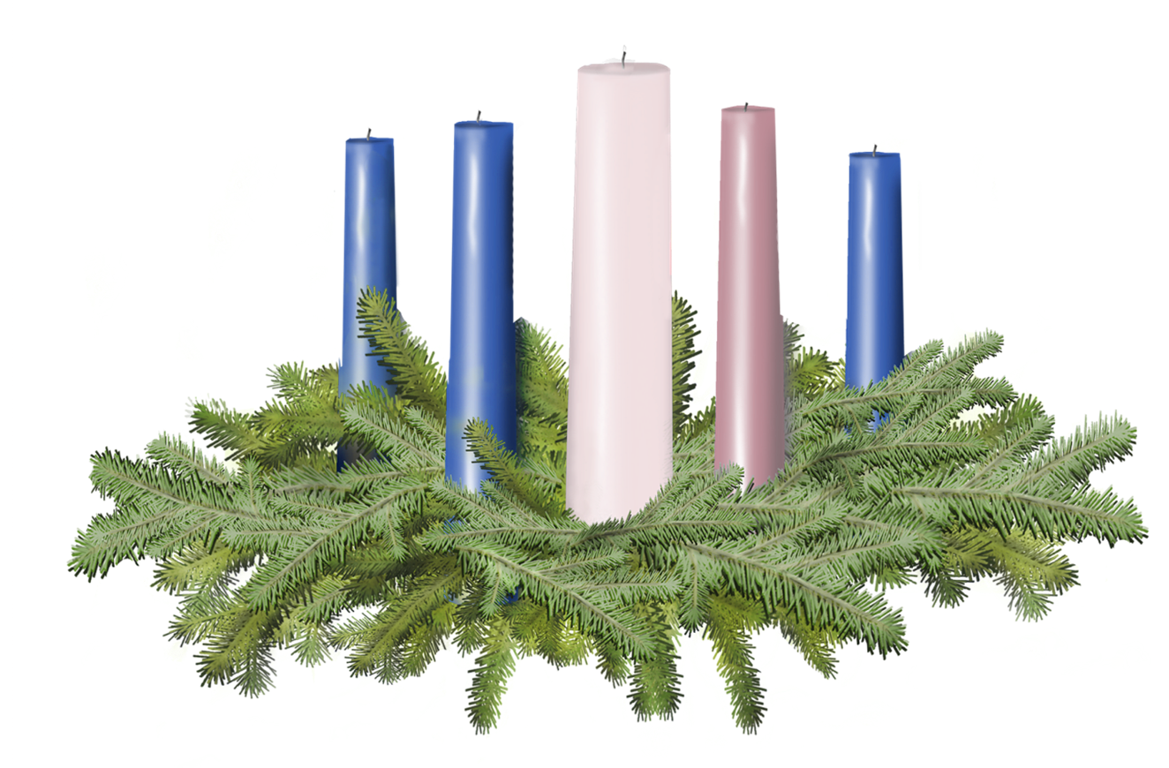

Light the candle of HOPE

Slide 7
One:
Let us pray together.
All:
Good and gracious God, God of darkness and light, God of hope and fear, help us take one step closer to you, toward the joy of unity with you. In this candle light, show us that the power of hope silences doubts and fears. Take this light, small but mighty, and magnify it within us until our hope chases away all shadows around our church, our community, our nations and our world. Amen.

Slide 8
Call to Offering
For churches receiving the Christmas Fund Offering today.
One:
What does it mean to hope?
It means to put your whole trust in God, believing that God’s promises of blessing will be fulfilled. For those who devote their talents, skills and time to our churches in the United Church of Christ, both authorized ministers and lay leaders, hope is a muscle. During this Advent season, we receive a Special Mission Offering for the UCC Christmas Fund, and we do this to show our gratitude for all our leaders.

Slide 9
Call to Offering Continued…
This offering will help both active and retired clergy meet basic financial needs like health care and retirement income. Moreover, the Christmas Fund Offering provides emergency assistance in times of financial strife. This offering is our chance to strengthen our own muscles of hope and to keep lit its beacon for those who serve the Church. Let us receive this morning’s offering.

Slide 10
Prayer of Dedication
One:
Please join me as we dedicate our gifts
All:
Gracious God, bestow upon our gifts your great blessing. For those who need them most, may they be the symbol of hope we wish to bear into this world. In giving them, strengthen our hope as we anticipate the birth of all hope, grace, and glory. Amen.

Slide 12
