Slide 1

CHRISTMAS EVE
Sunday, DECEMBER 24th
ADVENT V – CHRISTMAS EVE
Isaiah 9:2-7; Luke 2:1-20

Slide 2
Christmas Eve
As the liturgist approaches, the hymn, “O Come, O come Emmanuel” plays softly.
One:
As night falls, and the shadows grow long, we wait in hopeful expectation for the coming light.
All : Singing
O Come, O come, Emmanuel,
And ransom captive Israel,
That mourns in lonely exile here
Until the child of God appear.
Light the candle of Hope as the congregation sings.

Slide 3
One:
As war and violence swirl around us, we watch for the coming Prince of Peace.
All : Singing
O Come, desire of Nations, bind
All people in one heart and mind.
Bid all our sad divisions cease,
And fill the world with Heaven’s peace.
Light the candle of Peace while congregation sings.

Slide 4
One:
As we struggle amid the shadows and gloom, we drink deeply from the font of all joy.
All : Singing
O Come, Key of David come,
And open wide your heavenly home;
Make safe the path to endless day,
To death’s destruction close the way.
Light the candle of Joy while congregation sings.

Slide 5
One:
As love seems a rare commodity in our world, we cling to the love that will not let us go.
All : Singing
O Come, thou Dayspring, come and cheer
Our spirits by thine advent here;
Love stir within the womb of night,
And death’s dark shadows put to flight.
Light the candle of Love while congregation sings.

Slide 6
One:
People of God, rejoice, for a child has been born for us, a son given to us; authority rests upon his shoulders; and he is named Wonderful Counselor, Mighty God, Everlasting Mother, Prince of Peace.
All : Singing
Rejoice, Rejoice, Emmanuel shall come to thee O Israel.
Rejoice, Rejoice, Emmanuel shall come to thee O Israel.
Light the candle of Christ.

Slide 7

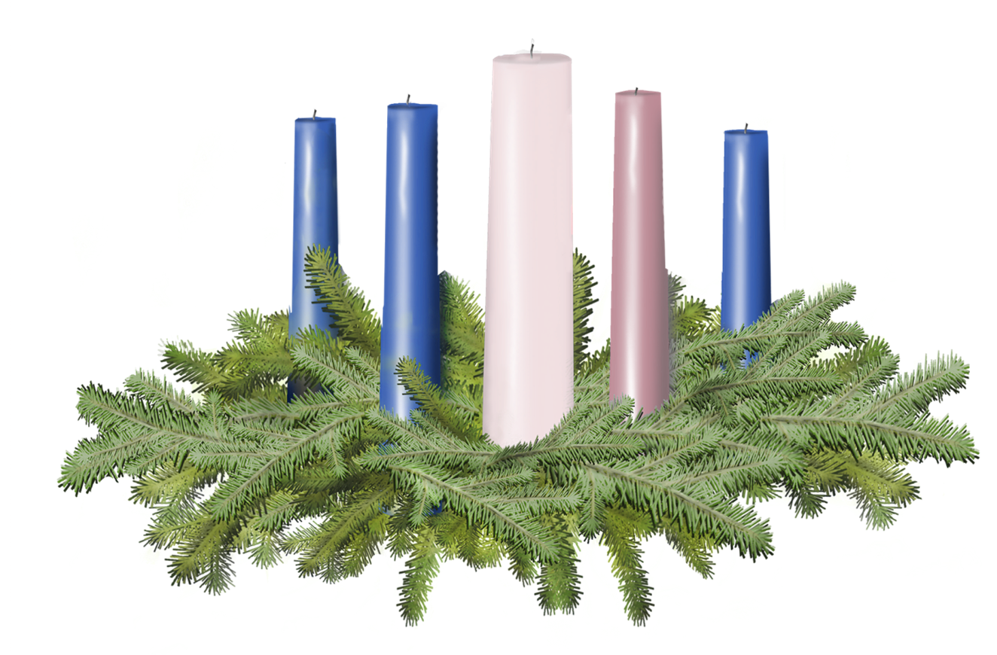
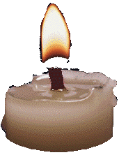
Light the candles of HOPE, PEACE, JOY, LOVE
Light the candle of CHRIST

Slide 8
Call to Offering
For churches receiving the Christmas Fund Offering today.
One:
When the shepherds met the newborn Christ, they immediately turned into preachers, choir members, and ministers. The text in Luke says, “the shepherds then returned to their fields glorifying and praising God for all they had seen and heard.” When we encounter Jesus it is natural to want to sing, to dance, to laugh, to gasp, to give. True generosity flows not from duty, but from awe.

Slide 9
Call to Offering Continued…
Tonight's offering will be given in whole to the Christmas Fund of the United Church of Christ. The Christmas Fund provides support for those who serve the church and are experiencing financial distress. Your gracious giving can be a light for those walking in shadows, it can be a hope for those into trying times, it can be love for those who feel forgotten. In the spirit of Christmas joy, please give as your are able.

Slide 10
Prayer of Dedication
One:
Please join me in prayer.
All:
Gracious God, we pray that you would richly bless and multiply these gifts. May all who receive these gracious offerings know that you are with them. And in our giving may we know that you are with us. We pray this in the name of Jesus the Christ, our Emmanuel, God with us, in our giving and our receiving. Amen.

Slide 12
