Slide 1


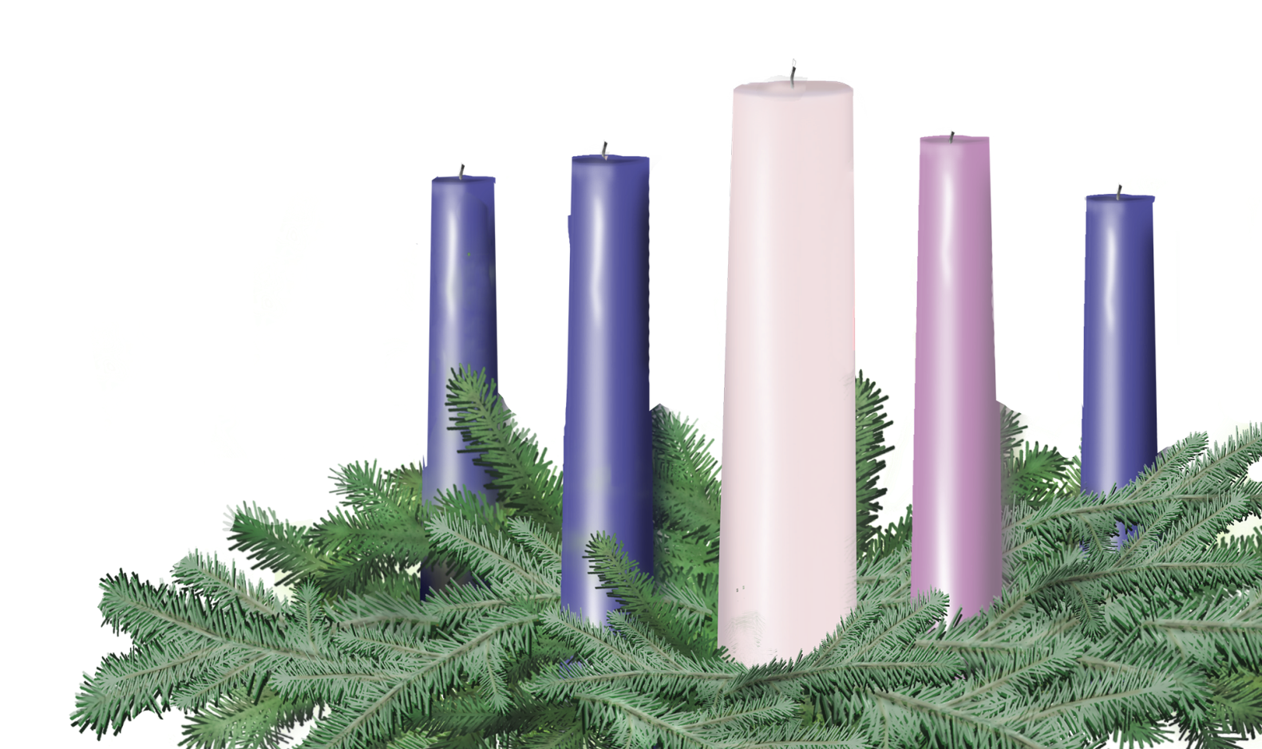

THIRD SUNDAY IN ADVENT
Sunday, December 14
Leader and Congregation
Psalm 126; John 1:6-8, 19-28

Slide 2
Third Sunday in Advent
A lay person or persons may be invited forward to lead the congregation.
One (or Leader)
Before we light the first Advent candle, please join me in a litany of preparation…

Slide 3
One
As we look to the great things that God has done for us, we remember:
Many
The Spirit of the Divine Creator is in our very midst, restoring the fortunes of Zion, reclaiming our hearts and this season of Advent, that all may know joy.
One
As we cry out in a wilderness of blaring ads, frantic sales, and celebration that can feel hollow once we get home, we remember:

Slide 4
Many
There is a deeper joy that has no price tag, and a baby boy who seeks to heal the deeper hurt, the real brokenness within and among us.
One
As we draw closer to the light of everlasting joy in this season, we remember and claim for our own lives:
Many
The courage and spirit of John the Baptizer to testify to the light that is coming into the world, a beacon of joy for all those who are searching.

Slide 5
One
We light these candles as reminders of the joy of Advent story, as well as the delight of retelling that story to others, that joy may abound all the more.

Slide 6
Lighting the First Three Candles
As the first, second and third candles are lit, the congregation may sing “Drawing Nearer” by Christopher Grundy (p. 9 Offering Guide or www.christmasfund.org).
Drawing Nearer
Even in the Midst of all of this
Trouble on the news, no peace within,
Still there is a light in the distance
Drawing nearer, drawing nearer
So, open up our eyes to see your light,
Open up our arms, they’re clenched so tightly,
Come in like a thief and steal our hearts
Like a baby, like a baby.
Even in the midst of all of this.

Slide 7
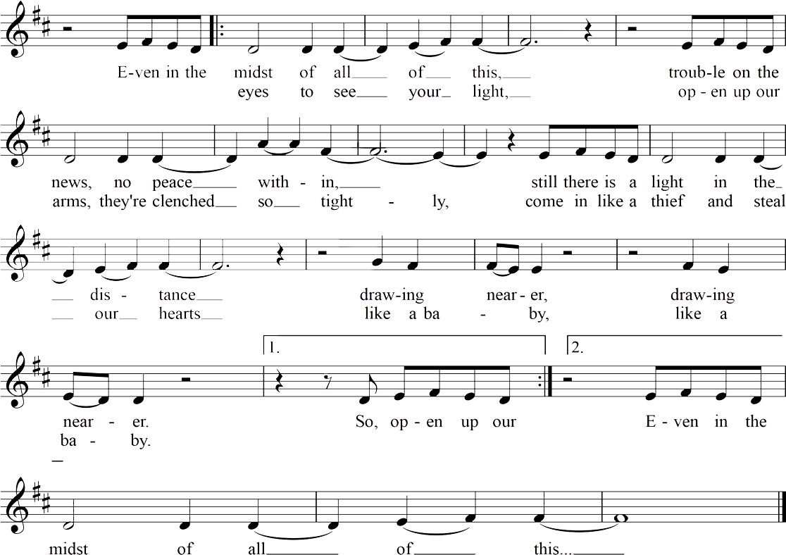
Drawing Nearer
Christopher Grundy

Slide 8

Light the candles of HOPE, PEACE and JOY

Slide 9
One
Let us pray.
Many
Source of all light and love, as we anticipate the Light of the World, draw us more deeply to this Season of Advent. Draw our eyes toward the pleasant glow of a life that has depth and meaning.
Draw our hearts out into the larger love that is your way in the world. When we are discouraged by the brokenness around us, help us to claim joy daily, as those who are welcoming the Christ child.
We pray in the name of the one who is, himself, good news of great joy for all the people. Amen.

Slide 10
One
Please join me in the prayer of dedication.
Many
Radiant light and our eternal joy, because of the gifts you have brought daily into our lives, we dedicate ourselves to giving as constantly as we receive. Bless these humble gifts, along with us, and all those who have served in ministries of peace and compassion.
Grant that we may each be bearers of your joy in this season, knowing the Emmanuel promise, that you are always drawing near. We pray in the name of Jesus, coming soon. Amen.

Slide 11



Slide 12
