Slide 1


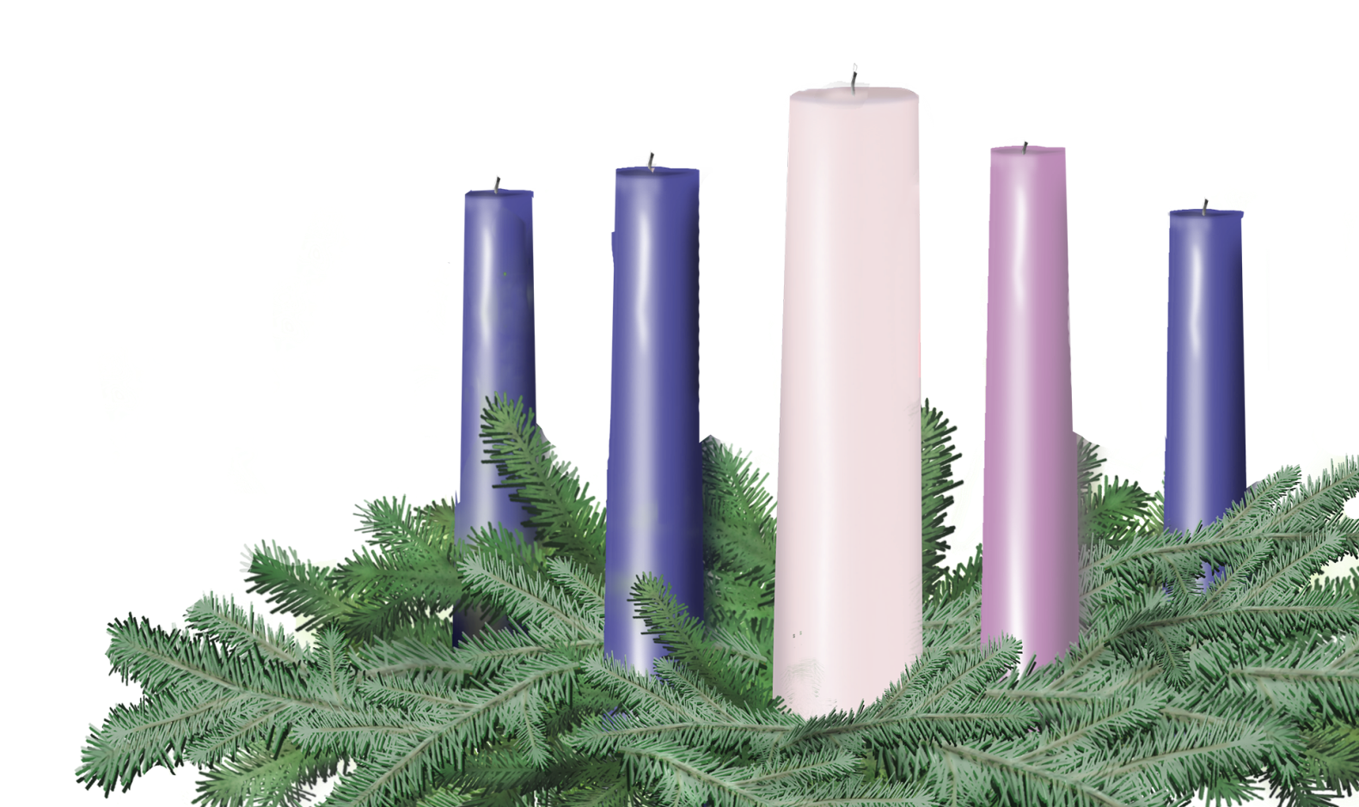
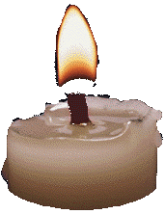
FIRST Sunday in Advent
Sunday, November 30th
Leader and Congregation
Psalm 80; Mark 13:24-37

Slide 2
First Sunday in Advent
A lay person or persons may be invited forward to lead the congregation.
One (or Leader)
Before we light the first Advent candle, please join me in a litany of preparation…

Slide 3
One
When it seems that, no matter where we look, the world is sunk in shadow, when the sun is darkened, and the moon will not give its light,
Many
Restore us, O God; let your face shine upon us.
One
When lighting one small candle and calling it “hope” feels like an act of futility,
Many
Restore us, O God; let your face shine upon us.

Slide 4
One
When we need to be reminded that even one small light can begin to warm the shadows around it,
Many
Restore us, O God; let your face shine upon us.
One
Because even one small light can assure us that you have not abandoned us, that even now your light is drawing near,
Many
Restore us, O God; let your face shine upon us.

Slide 5
One
As we light this one small candle, O God, we remember that our sisters and brothers all over this world are lighting candles of their own, and that all of us together, with your help, can carry a light of hope into the deepest, most foreboding corners, where you, amazingly, are already at work.
Many
Restore us, O God; may our faces shine with your light.

Slide 6
Lighting the First Candle
As the first candle is lit, the congregation may sing “Drawing Nearer” by Christopher Grundy (p. 9 Offering Guide or www.christmasfund.org).
Drawing Nearer
Even in the Midst of all of this
Trouble on the news, no peace within,
Still there is a light in the distance
Drawing nearer, drawing nearer
So, open up our eyes to see your light,
Open up our arms, they’re clenched so tightly,
Come in like a thief and steal our hearts
Like a baby, like a baby.
Even in the midst of all of this.

Slide 7
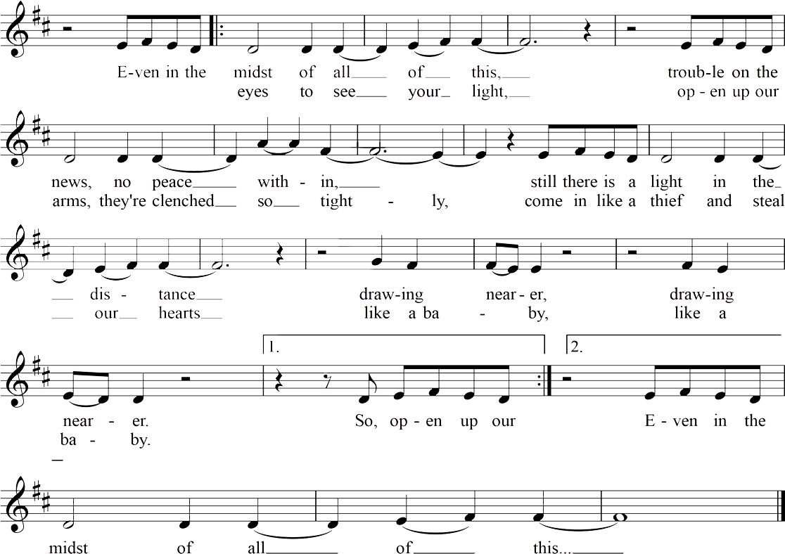
Drawing Nearer
Christopher Grundy

Slide 8

Light the candle of HOPE

Slide 9
One
Let us pray.
Many
Gracious God, remind us in the events of each day that no matter what the world around us brings, you are our light, drawing ever nearer. With this one small candle, strengthen us to join our own light with yours, and to be ever watchful for your in-breaking realm in our midst.
Let this one small candle kindle hope: in our hearts, in our community, and in our world. Amen.

Slide 10
One
Please join me in a prayer of dedication.
Many
Glorious God, take these gifts and kindle them with your light. May they bring hope to those who sit in shadow, may they light the way to your intention for all people, and may they be a reminder that you are drawing ever nearer. Amen.

Slide 11


Slide 12
