Slide 1


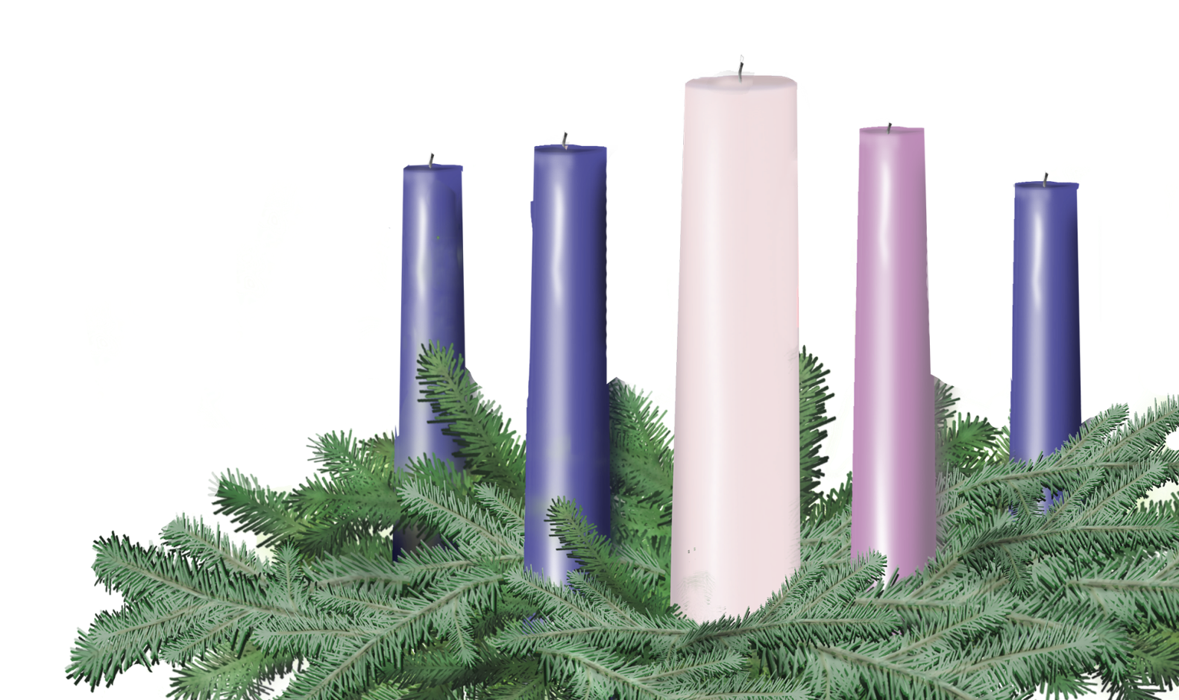
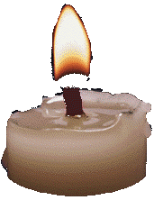
CHRISTMAS EVE
Wednesday, December 24
Leader and Congregation
Isaiah 9:2-7; Luke 2:1-14

Slide 2
Fourth Sunday in Advent
A lay person or persons may be invited forward to lead the congregation.
One (or Leader)
Before we light the first Advent candle, please join me in a litany of preparation…

Slide 3
One
Though the holiday lights are bright, shadows remain in the world around us.
Many
Some of us have walked in those shadows. Some walk there even now.
One
Though the warm glow of holiday cheer pushes back the long, looming nights,
Many
Some among us in this world have lived in a land of darkness, and will live there still when the season has passed – a land of violence, tragedy, and grief.

Slide 4
One
Tonight we light our few small candles – a paltry glimmer when we think of the world outside. We light them not to banish the shadows, to somehow vanquish the night, but to change the heart of darkness. For God dwells even there, in the darkness of a barn, deep in the shadows of a stall, down in the pitch black of a feeding trough, with only a faint glimmer of starlight outside.
Many
In that holy darkness, God comes to us and shares our common lot.

Slide 5
One
One fragile, incandescent life, to begin the world anew. “A light shines in the darkness, and the darkness did not overcome it.” Instead, the darkness itself is found to have a holiness all its own.

Slide 6
Lighting the Candles
As the five candles are lit, the congregation may sing “Drawing Nearer” by Christopher Grundy (p. 9 Offering Guide or www.christmasfund.org).
Drawing Nearer
Even in the Midst of all of this
Trouble on the news, no peace within,
Still there is a light in the distance
Drawing nearer, drawing nearer
So, open up our eyes to see your light,
Open up our arms, they’re clenched so tightly,
Come in like a thief and steal our hearts
Like a baby, like a baby.
Even in the midst of all of this.

Slide 7
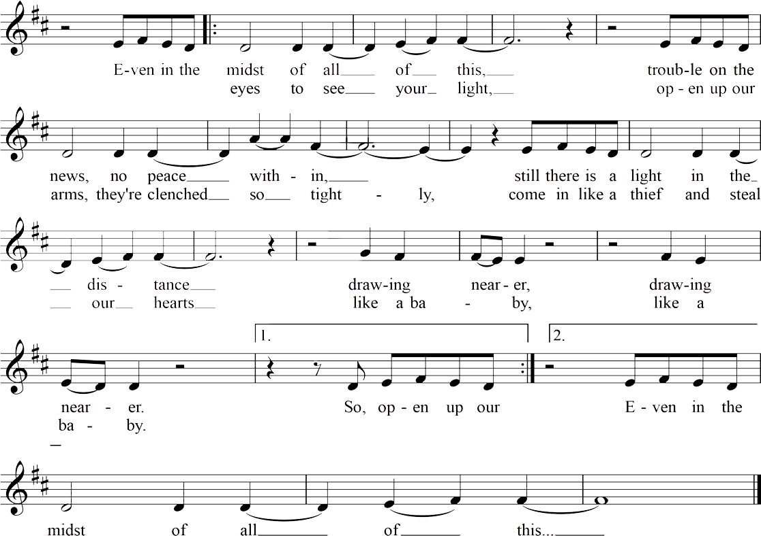
Drawing Nearer
Christopher Grundy

Slide 8

Light the candles of HOPE, PEACE, JOY and LOVE

Slide 9
Light the Christ Candle

Slide 10
One
Please join me as we pray together.
Many
God of the shadows, God of the night, God of the dark alley, the deep mine, the basement cell, even the darkness is as light to you.
With these candles shining, as signs of your amazing love, we give thanks that in Jesus Christ you have made it plain that you are always drawing near. On this night, and for many nights to come, help us to face the shadows within and around us, and to risk being a light, however small, for the sake of the difference it can make, for the sake of your kin-dom coming near, for the sake of the Christ child, a tiny light born among us, in whose name we pray. Amen

Slide 11
One
Please join me in a prayer of dedication.
Many
Gracious One, Source of all the sacred mysteries that surround us – like the birth of a child, like starlight crossing millions of miles, like the hushed, unlikely togetherness of strangers in a barn – tonight we can see more clearly that everything is a gift. Thank you .
Bless whatever small portion of your abundance we return here. Bless us also, that our worlds, our choices, the way we treat our co-workers, our family, even strangers, may be a gift you are giving to the world. We pray in the name of Jesus, light of the world. Amen.

Slide 12


Slide 13
